Slide 1
Instructions for operating the new Cost Transfer system
（Web system ）
Made by: Foxconn Technology Group
Corporate Accounting Dept
DATE： 2012/06/29

Slide 2
Background：
Recently, Super Notes is being used instead of Notes in our group .To avoid the affection of Notes transfer,
the IT team has developed Web system.
Cost Transfer web system will be available for HH from the day July 1st,2012.

Slide 3
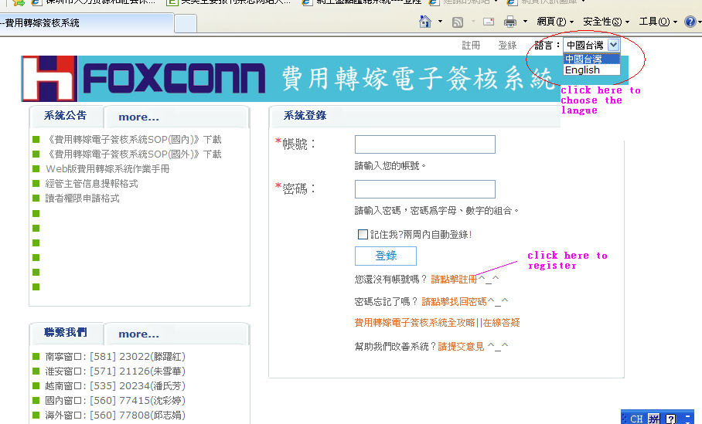
The Web system add: http://ct.efoxconn.com/
All the users should register for the first time logging in

Slide 4
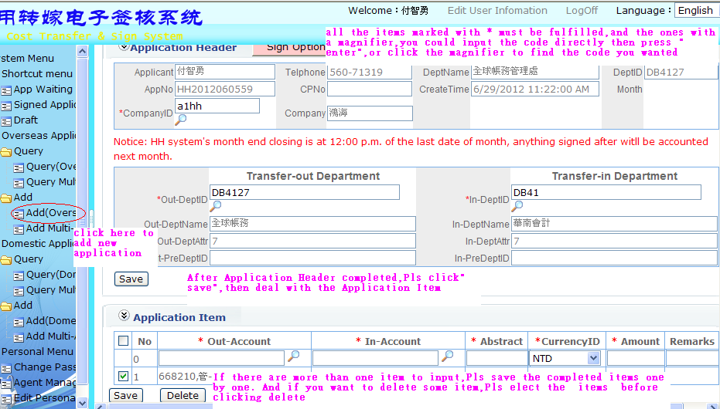
No 1. Add new application
1.App Header and App Item：

Slide 5
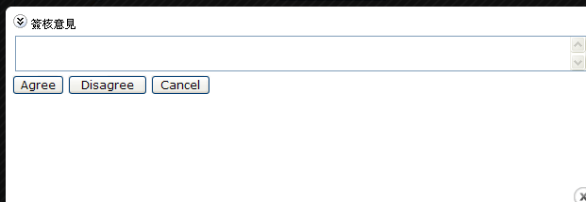
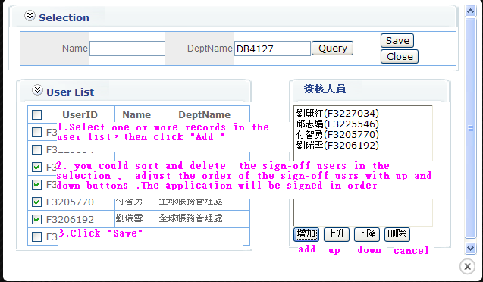
2. Sign-off process
2.1.Applicant of cost transfer select Auditor ,Approver ,
CM and CM manager，then submit the application.
click the "sign option“
2.2 Applicant of cost absorber complete Auditor, Approver, CM ,
and CM manager of cost absorber , then submit.
2.3 To select multiple users of Auditor, Approver, CM, click the list box then display the below pop-up box.（All the sign-off users must register firstly）

Slide 6
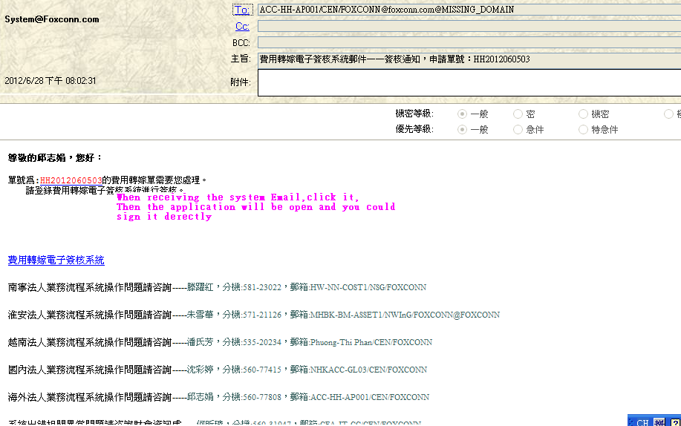

3. The system will send email to inform the current undertaker to audit it

Slide 7
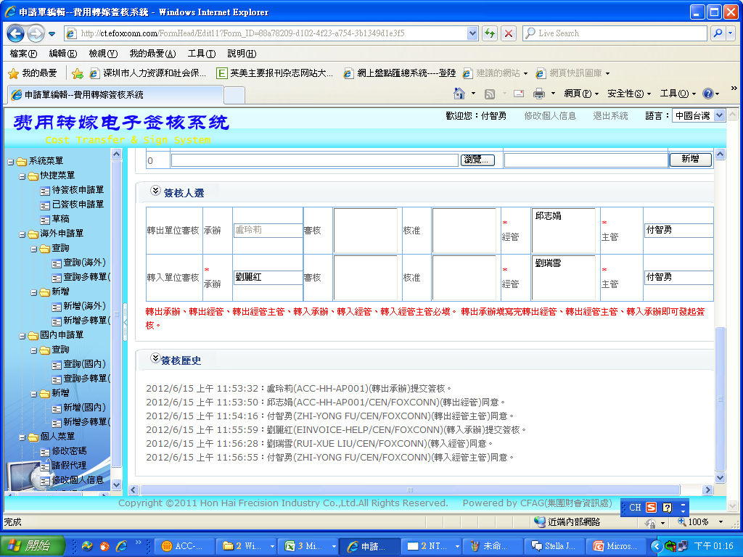
4. After CM manager of cost absorber approval, the entire sign-off process is completed

Slide 8
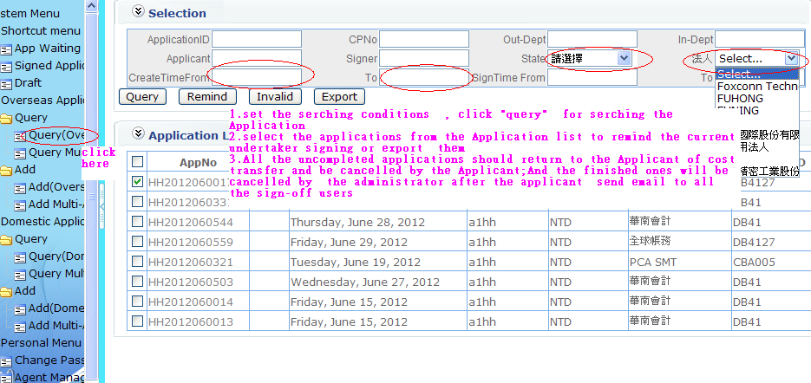
二、Applications to query ,invalid and export

Slide 9
Fill instruction for cost transfer file
One cost transfer document can only have one currency.
The sign flow is: Applicant of cost transferor →Auditor of cost transferor → Approver of cost transferor → CM of cost transferor → CM Manager of cost transferor → Applicant of cost absorber→ Auditor of cost absorber → Approver of cost absorber → CM of cost absorber → CM Manager of cost absorber
Applicant and CM manager can only choose one person for each, and the other column can choose one person or more.
Rejection in any station will return application to the first station, Applicant of cost transferor .

Slide 10
The principle for ledger file creation
Cost transfer application will copy to financial system after sign completed
The administrators will copy each day.
The ledger is designed to begin with GCH.
The ledger date is the copy date
The rate is the copy month rate
The remark column is filled with cost transfer system No.
According to the remark, we can return to the cost transfer system to find the related sign information
The ledger remark have two parts: the first is fixed to be transferor code to absorber code; the second is the description input by user.
The ledger is made by each application item.

Slide 11
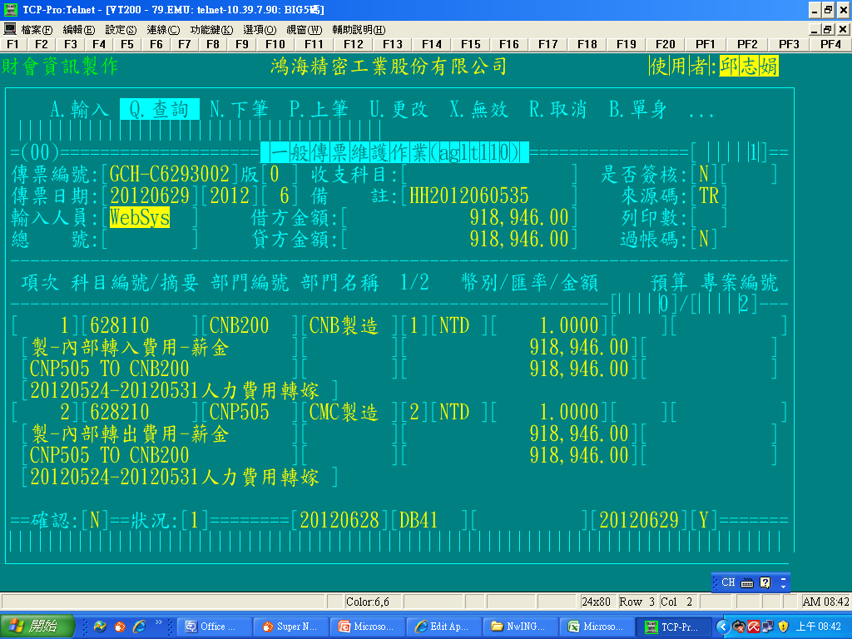
Copy date
Application No.
summary1
summary 2

Slide 12
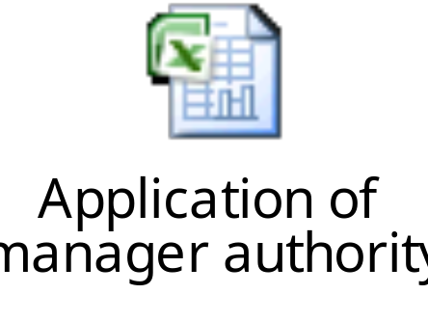
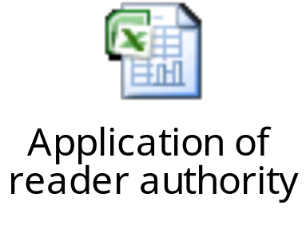
Contacts：
IT :
Hu Zhang（張虎）, CFA-IT-WEB/CEN/FOXCONN, 560-77475
Xinlin He（何昕璘）， CFA-IT-CC/CEN/FOXCONN,560-31947
Accountant：
Zhijuan Qiu（邱志娟）， ACC-HH-AP001/CEN/FOXCONN,560-77808
Questions:
If you cannot find the manager in the sign-process or you want to read all the applications related to your BU code, Please send the message as the attached to the IT or Accountant.

Slide 13
Thanks

